Slide 1
U.S. General Services Administration
DOING BUSINESS WITH GSA
The Office of Small & Disadvantaged Business Utilization (OSDBU)
Advocating for our Nation’s Small Businesses

Slide 2
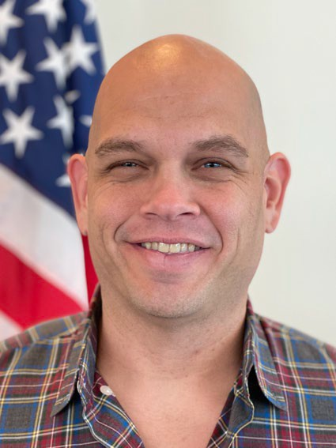
Today’s Presenters
Today’s Presenters
Anthony Caruso
Senior, Small Business Technical Advisor
GSA, Office of Small and Disadvantaged Business Utilization (OSDBU)
Pacific Rim - Region 9
Lori Falkenstrom
Small Business Specialist
GSA, Office of Small and Disadvantaged Business Utilization (OSDBU)
Pacific Rim - Region 9

Slide 3
Agency Overview
The U.S. General Services Administration (GSA) is one of the federal government's largest buyers, contracting for billions of dollars’ worth of products and services each year for its U.S. government “customers.” These customers include most agencies of the executive, judicial, and legislative branches and federal government and military facilities worldwide.
GSA rents, builds, furnishes, and maintains government offices and buys products ranging from pens to state-of-the-art computers. GSA also contracts for services as varied as trash removal and information technology.
Mission-
“Deliver value and savings in real estate, acquisition, technology, and other mission-support services across government.”
www.gsa.gov

Slide 4
Agency Overview (Cont.)
Agency Overview (Cont.)
Public Buildings Service
(PBS)
As the landlord for the civilian federal government, PBS acquires space on behalf of the federal government through new construction and leasing, and acts as a caretaker for federal properties across the country.
PBS owns or leases 8,800 assets, maintains an inventory of more than 370 million square feet of workspace, and preserves more than 500 historic properties.
What does PBS Procure?
Construction A&E Services Janitorial Landscape Interior Design Painting HVAC Lighting Security Window Washing Electrical Lease
Where are the PBS Opportunities?
GSA Forecast
GSA Subcontracting
Sam.gov
GSA Multiple Award Schedules (MAS)
Indefinite Delivery Indefinite Quantities (IDIQ)
www.gsa.gov/pbs

Slide 5
Agency Overview (Cont.)
Agency Overview (Cont.)
Federal Acquisition Services
(FAS)
GSA is America's only source solely dedicated to procuring goods and services for government.
As an integral part of GSA, FAS possesses unrivaled capability to deliver comprehensive products and services across government at the best value possible
What does FAS Procure?
Environmental Services Moving Services
Information Technology Transportation
Furniture Law Enforcement Equipment
Professional Training Telecom & Network Services
Travel Services Staffing Services
Where are the FAS Opportunities?
GSA Forecast
GSA Subcontracting
Sam.gov
GSA Multiple Award Schedules (MAS)
Indefinite Delivery Indefinite Quantities (IDIQ)
Governmentwide Acquisition Contracts (GWAC)
https://www.gsa.gov/fas
www.gsaauctions.gov

Slide 6
Agency Overview (Cont.)
Agency Overview (Cont.)
Office of Small and Disadvantaged Business Utilization (OSDBU) | Federal Acquisition Service (FAS)
www.gsa.gov/small-business
We believe in Small Business First.
According to the Small Business Act as amended by Public Law 95-507, the Office of Small & Disadvantaged Business was established to:
Advocate, within each Federal Executive Agency, for the maximum practicable use of all designated small business categories within the Federal Acquisition process.
Ensure inclusion of small businesses as sources for goods and services in federal acquisitions as prime contractors and subcontractors.
Manage the small business utilization programs for each respective organization.

Slide 7
Office of Small & Disadvantaged Business Utilization (OSDBU)
Achievement & Small Business Procurement Scorecard History
Fiscal Year | Small Business Goal | Prime SB Goal Achievement | Subcontracting Goal | Subcontracting Goal Achievement | Scorecard Grade
FY 2021 | 30% | 46.89% ($2.7B) | 20% | 25.80% | A+
FY 2020 | 29% | 49.43% ($2.6B) | 24% | 29.30% | A+
FY 2019 | 30% | 42.69% ($2.4B) | 25.50% | 22.10% | A+
FY 2018 | 35% | 39.37% ($1.9B) | 26.50% | 24.70% | A
FY 2017 | 36.50% | 42.68% ($1.9B) | 29.00% | 23.90% | A
FY 2016 | 36.50% | 39.23% ($1.6B) | 29.00% | 31.30% | A
Service Disabled Veteran Owned
Small Businesses
Small Businesses located in HUBZones
Small Disadvantaged
Businesses
Women Owned
Small Businesses

Slide 8
GSA Small Business Goals
Fiscal Year 2022 Goals and Achievements (Year-to-Date*)
Total Eligible Dollars $5.87B
SB Category | FY22 Goals | FY 22 Achievement % | FY22 Achievement $
Small Business (SB) | 34% | 47.85% | $2.81 Billion
Small Disadvantaged Business (SDB) | 21% | 22.43% | $1.3 Billion
Women-Owned Small Business (WOSB) | 5% | 9.98% | $586.0 Million
Service Disabled Veteran Owned Small Business (SDVOSB) | 3% | 9.45% | $555.0 Million
Certified Historically Underutilized Business Zone (HUBZone) | 3% | 6.87% | $403.8 Million
*Achievements as of 1-12-2023

Slide 9
Government Wide Contracting Goals
GSA Small Business Goals (Cont.)
GSA Fiscal Year 2023 Small Business Goals
Small Business Category | Represented Goal
Small Business (SB) | 23%
Small Disadvantaged Business (SDB) | 12%
Women-Owned Small Business (WOSB) | 5%
Service Disabled Veteran Owned Small Business (SDVOSB) | 3%
Certified Historically Underutilized Business Zone (HUBZone) | 3%
SB Category | FY23 Prime Goals
Small Business (SB) | 33%
Small Disadvantaged Business (SDB) | 21.9%
Women-Owned Small Business (WOSB) | 5%
Service Disabled Veteran Owned Small Business (SDVOSB) | 3%
Certified Historically Underutilized Business Zone (HUBZone) | 3%

Slide 10
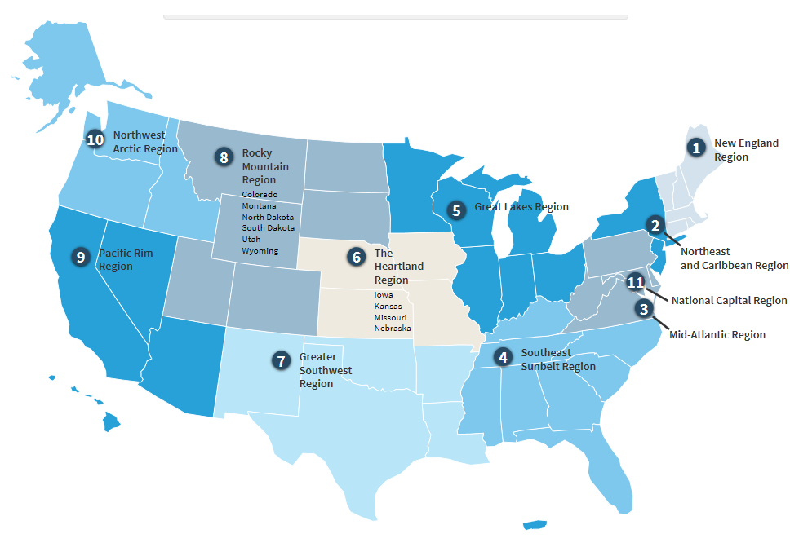
Agency Overview (Cont.)
Agency Overview (Cont.)
Office of Small and Disadvantaged Business Utilization (OSDBU)
Small Business Goaling Small Disadvantaged Business (SDB) 8(a) Women-owned Small Business Historically Underutilized Business Zone (HUBZone) Veteran-owned Small Business Service Disabled Veteran-owned Small Business Small Business Subcontracting Program Forecast of Contracting Opportunities UPDATE: SBA’s Veteran Small Business Certification Program is now open. Visit www.sba.gov/vetcert to review the information and resources. SBA Fact Sheet on “How to apply for certification” Visit: https://www.sba.gov/brand/assets/sba/resource-partners/Preparing-for-certification-VetCertFactSheet-508c.pdf
www.gsa.gov/contactgroup/small-business-support

Slide 11
Minimum Requirements
Unique Entity Identifier (UEI)
Assigned through SAM.GOV registration
www.gsa.gov/entityid
System for Award Management (SAM)
Register Here
www.sam.gov
Size Standards
Determine your size of business
www.sba.gov/federal-contracting/contracting-guide/size-standards
North American Industry Classification System (NAICS) Industry Codes
Identify your NAICS
www.census.gov/naics
Small Business Administration (SBA)
Business Categories
Small Disadvantaged Business (SDB)
8(a)
Women-owned Small Business
Historically Underutilized Business Zone (HUBZone)
Veteran-owned Small Business
Service Disabled Veteran-owned Small Business
www.sba.gov/federal-contracting/contracting-assistance-programs

Slide 12
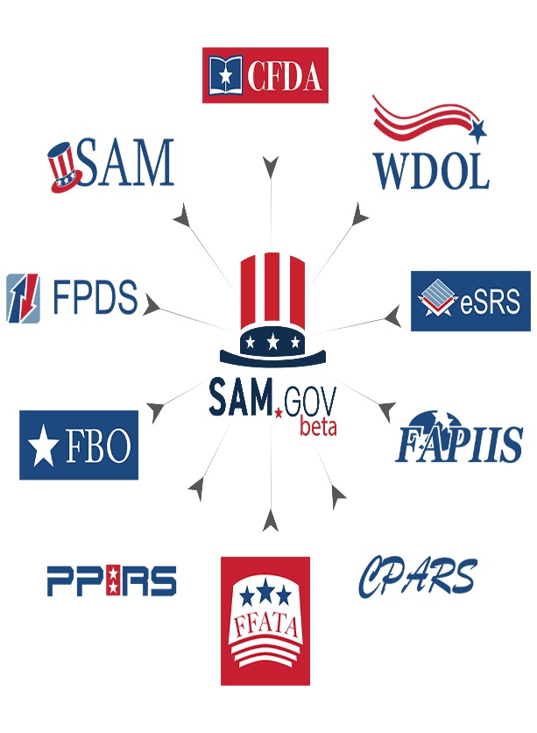
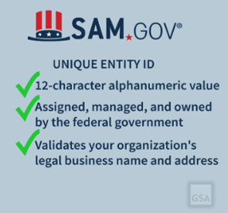
System for Award Management (SAM)
Sam.Gov includes the following:
Contract Opportunities: (Formerly fbo.gov)
Contract Data: (Reports only. From fpds.gov)
Wage Determinations: (Formerly wdol.gov)
Entity Registration: (Combined with the former beta.sam.gov)
Entity Reporting
Assistance Listings: (Formerly cfda.gov)

Slide 13
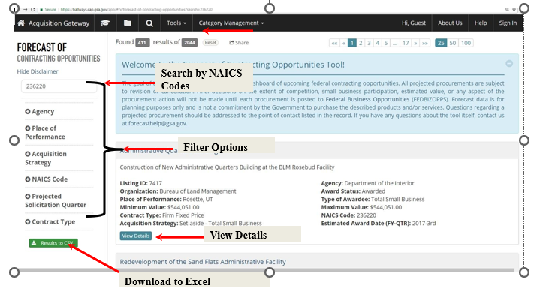
GSA Forecast of Contract Opportunities
GSA Forecast of Contracting Opportunities
How to Access the Forecast Tool:
Background
Focuses on acquisition planning and increases awareness of potential prime and subcontracting opportunities.
The goal is to help both GSA buyers and vendors easily communicate around potential contracting opportunities.
The tool includes information for GSA, Department of Interior, Department of Labor, U.S. Small Business Administration, and U.S. Office of Personnel Management
Forecast Website Access:
https://hallways.cap.gsa.gov
https://www.fbf.gov
https://www.acquisition.gov/procurement-forecasts

Slide 14
GSA Multiple Award Schedules (MAS)
WHAT IS A GSA MAS?
PROS AND CONS
MINIMUM REQUIREMENTS
GSA MAS stands for Multiple Award Schedules (MAS)
MAS is a Government-wide contract vehicle for commercial products, services, and other solutions
Multiple Award, Indefinite-Delivery, Indefinite-Quantity (IDIQ) contracts
5-year base period and three 5-year option periods
Performance requirements established at the order level to meet the federal customer’s specific needs
Single standing solicitation open continuously posted on SAM.gov
Over 19,000 Schedule contracts -- 80% are with small businesses
A contract
Another arena to bid on opportunities
Increases visibility to government customers
Not a certification
No guaranteed sales
Not mandatory to do business with the government
Not mandatory for other agencies to use
Not used for Construction (236220)
You must generate at least $25,000 in sales within the first 2 years of your GSA Schedule contract and at least $25,000 each year thereafter.
The average time it takes to secure a contract is between 18-24 months (according to the SBA).
Must be in business for two years and you must provide two years of financial statements
Ability to demonstrate past performance
Products must be commercially available
Products must be compliant with the Trade Agreements Act

Slide 15
GSA Multiple Award Schedules (MAS) (Cont.)
MAS PRODUCTS/SERVICES
MAS RESOURCES
WHERE DO I START?
Facilities Maintenance & Management
Office, Imaging and Documents Solutions
Transportation, Delivery, and Relocation Solutions
Hardware Superstore
General Purpose Commercial Information Technology Equipment, Software and Services
Furniture
Comprehensive Furniture Management Services
Furnishing and Floor Coverings
Food Service, Hospitality, Cleaning Equipment and Supplies, Chemicals, and Services
Temporary Administrative and Professional Staffing
Office Products/Supplies & Services and New Products/Technology
GSA Interact - MAS updates and information - https://interact.gsa.gov/groups/multiple-award-schedules
MAS Office Hours Monthly Webinars - gsa.gov/events to view the calendar
View previous MAS Office Hours webinars - https://www.youtube.com/playlist?list=PLvdwyPgXnxxX3I6FfCXIB5GK0QKfi1EEq
GSA MAS Questions - Email: MASPMO@gsa.gov
GSA Multiple Awards Schedules (MAS) Roadmap – www.gsa.gov/masroadmap
Qualifications
Instructions
Preparation
Mandatory Training
Submission
GSA eLibrary – www.gsaelibrary.gsa.gov
Determine if your product or service falls under the GSA MAS
View other GSA MAS Contract Holders and their pricelist

Slide 16
GSA Governmentwide Acquisition Contracts (GWAC)
www.gsa.gov/gwac
8(a) STARS III: GWAC offers access to highly qualified, certified 8(a) small disadvantaged businesses. The contract has a $10 Billion program ceiling with a five-year base period and one five-year option. VETS 2 (SDVOSB): GWAC set-aside exclusively for Service-Disabled, Veteran-Owned Small Businesses (SDVOSB). VETS 2 is designed to meet a variety of diverse agency IT requirements, including new and emerging technologies. The contract has a $5 Billion program ceiling with a five-year base period and one five-year option. Alliant 2: GWAC represents the next generation GWAC vehicle for comprehensive information technology (IT) solutions through customizable hardware, software, and services solutions purchased as a total package. | Alliant 3 Request for Proposal (RFP) will be solicited no earlier than the First Quarter of Fiscal Year 2024. View the Draft Request for Proposal (RFP) on sam.gov https://sam.gov/opp/662de9cafbdd4398af442c8bc12d59e9/view Polaris updates and next steps will be communicated through SAM.gov. Small Business GWAC Community https://interact.gsa.gov/group/small-business-gwac-community-interest
 | Email: MASPMO@gsa.gov
GSA Interact

Slide 17
One Acquisition Solution for Integrated Services (OASIS)
www.gsa.gov/OASIS
OASIS Unrestricted is a Full and Open contract OASIS Small Business is a 100% Small Business Set-Aside OASIS 8(a) were developed to provide the 8(a) community expanded access to the OASIS contract program while creating more options for federal agencies to meet their 8(a) business development program goals Core Services Include: Program management services Management consulting services; Logistics services Engineering services Scientific services Financial services. OASIS Questions: Oasis@gsa.gov Visit: www.gsa.gov/OASIS | OASIS+ is a suite of contracts that combines the scope of OASIS, Building, Maintenance & Operations (BMO) and Human Capital & Training Solutions (HCaTS) under one program Designed to support federal agencies’ procurement requirements for services-based solutions Access to highly qualified contractors of all sizes from multiple industries OASIS+ Questions: PSHC-dev@gsa.gov Visit: OASIS+ Interact Community https://buy.gsa.gov/interact/community/196/activity-feed
 | Email: MASPMO@gsa.gov

Slide 18
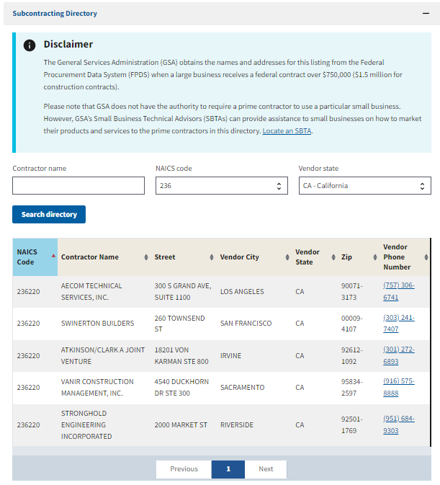
ACCESSING FEDERAL CONTRACT OPPORTUNITIES (CONT.)
GSA Subcontracting (Nationwide)
When a large business receives a federal contract over $750,000 ($1.5 million for construction contracts)
Utilize GSA's Subcontracting Directory and GSA’s eLibrary to find potential large prime business contractors.
Small businesses must contact prime contractors directly
www.gsa.gov/subdirectory
www.gsaelibrary.gsa.gov

Slide 19
Small Business Resources
APEX Accelerators (Formerly known as Procurement Technical Assistance Center- PTAC) | Training and counseling on Marketing, Financial, and Contracting www.aptac-us.org/new/ https://www.apexaccelerators.us/
Small Business Administration (SBA) | Procurement Center Representatives (PCRs) - https://www.sba.gov/contracting/resources-small-businesses/pcr-directory SBA Business Development Centers – https://www.sba.gov/tools/local-assistance/sbdc Get free and confidential mentoring through SCORE - https://www.score.org

Slide 20
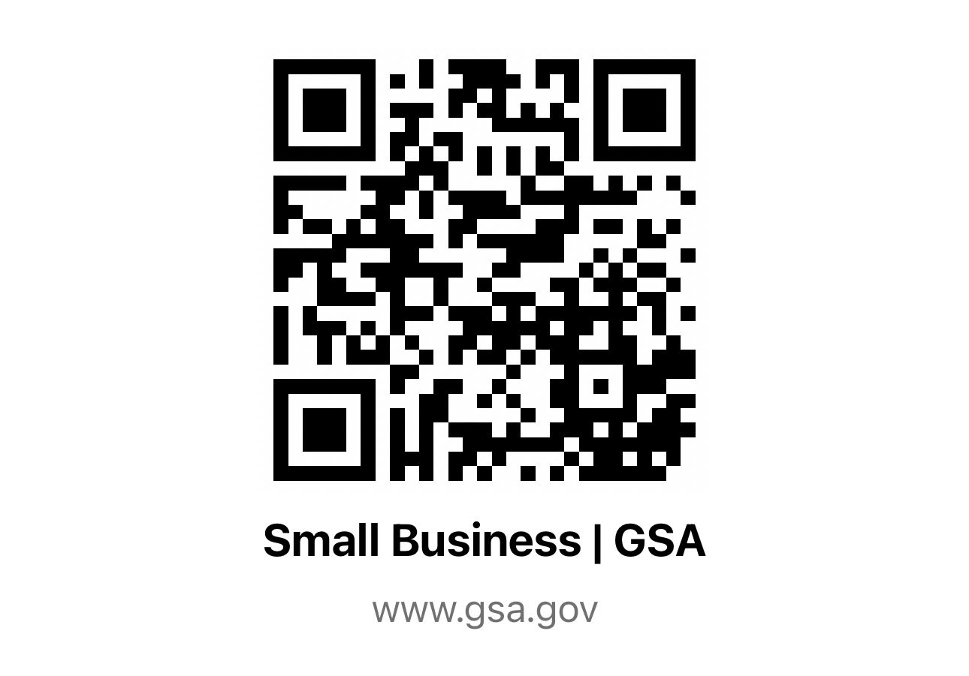
GSA Office Of Small And Disadvantaged Business Utilization (OSDBU)
Anthony Caruso
Senior, Small Business Technical Advisor
email: anthony.caruso@gsa.gov
Ph. 213-200-0946
GSA Region 9 – Pacific Rim
California, Hawaii, Nevada & Arizona
VISIT OUR GSA SMALL BUSINESS WEBSITE
Lori Falkenstrom
Small Business Specialist
email: lori.falkenstrom@gsa.gov
Ph. 415-515-6194
GSA Region 9 – Pacific Rim
California, Hawaii, Nevada & Arizona

